Slide 1

Final Prototype Presentation
Team Gold - Inclusive Classroom
DEC 8,2021 | CS 411W | Fall 2021

Slide 2
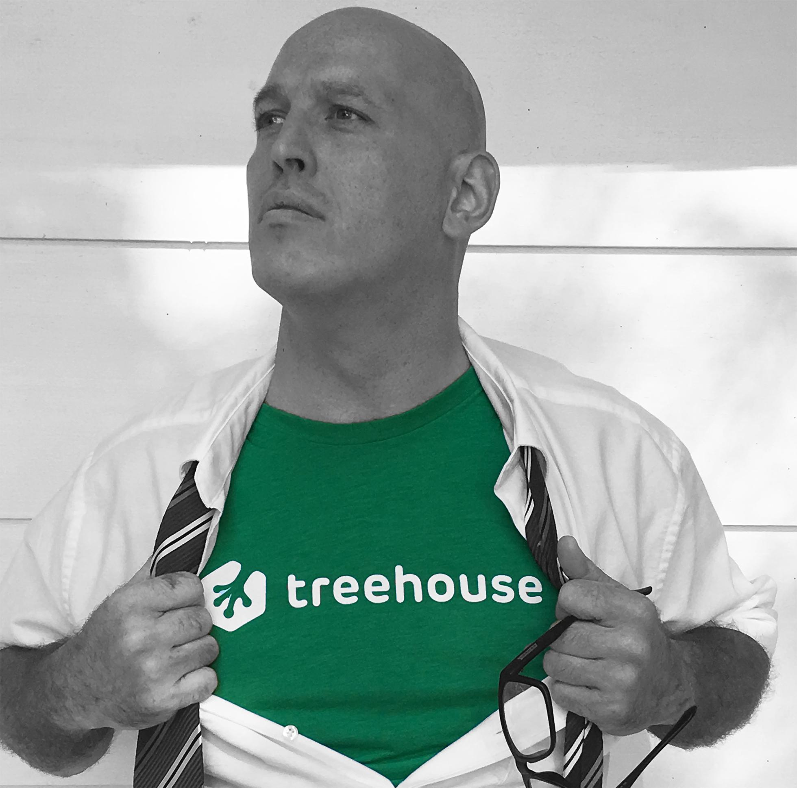
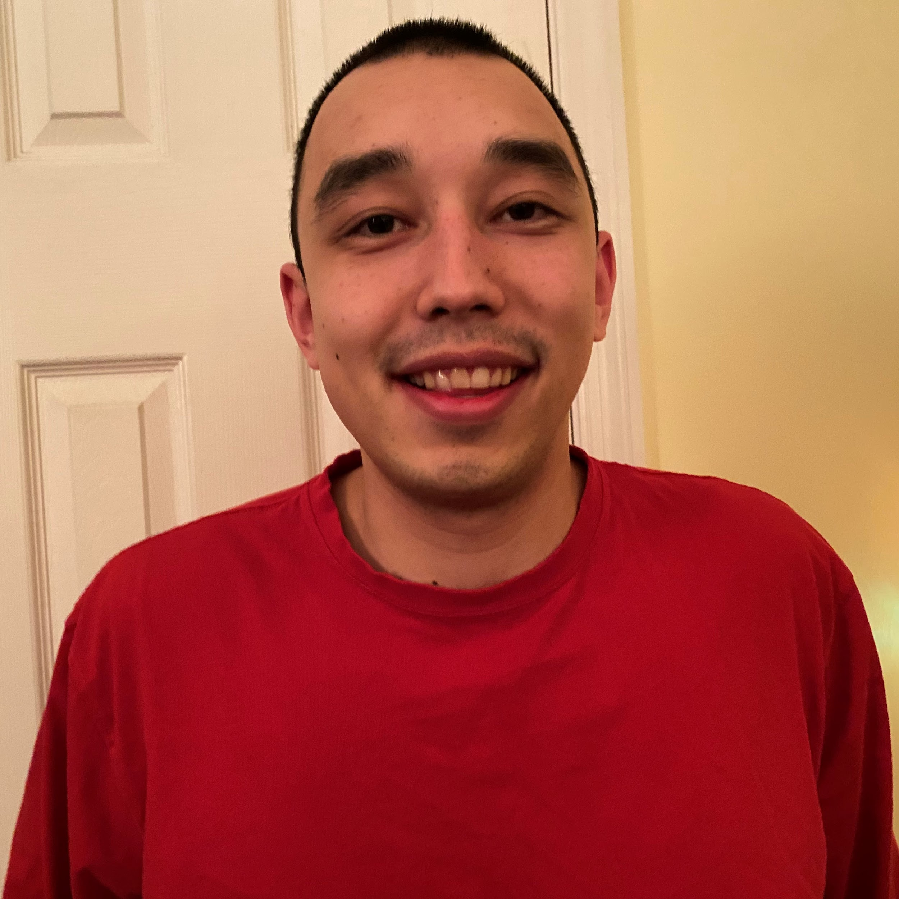
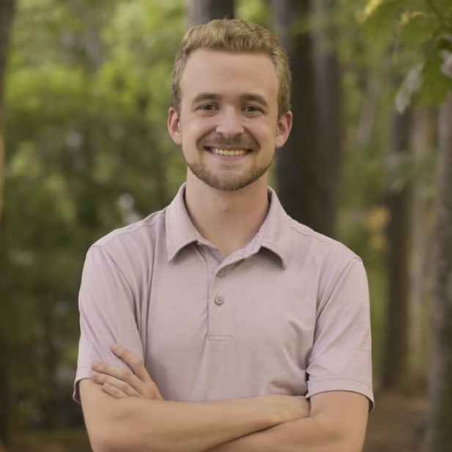
Team Members and Biographies
Randy Layne
Project Manager
Randy Layne is a linked Bachelor/Master Computer Science student at ODU and a full time Ruby on Rails developer and Snowflake SQL data engineer for Treehouse. Outside of studying and working he enjoys being a single dad of a wonderful 12 year old young lady.
Travis Bennett
Team Lead - Student App
Travis Bennett is a computer science senior at ODU. In his free time he enjoys watching sports, and playing games with family.
Grant Ralls
Team Lead - Teacher App
Grant Ralls is a Computer Science student at Old Dominion University and Software Engineer for Ferguson Enterprises. Outside of technology he enjoys reading and listening to music.
FINAL PROTOTYPE PRESENTATION
12/8/21
Notes:
Just read the slides.

Slide 3

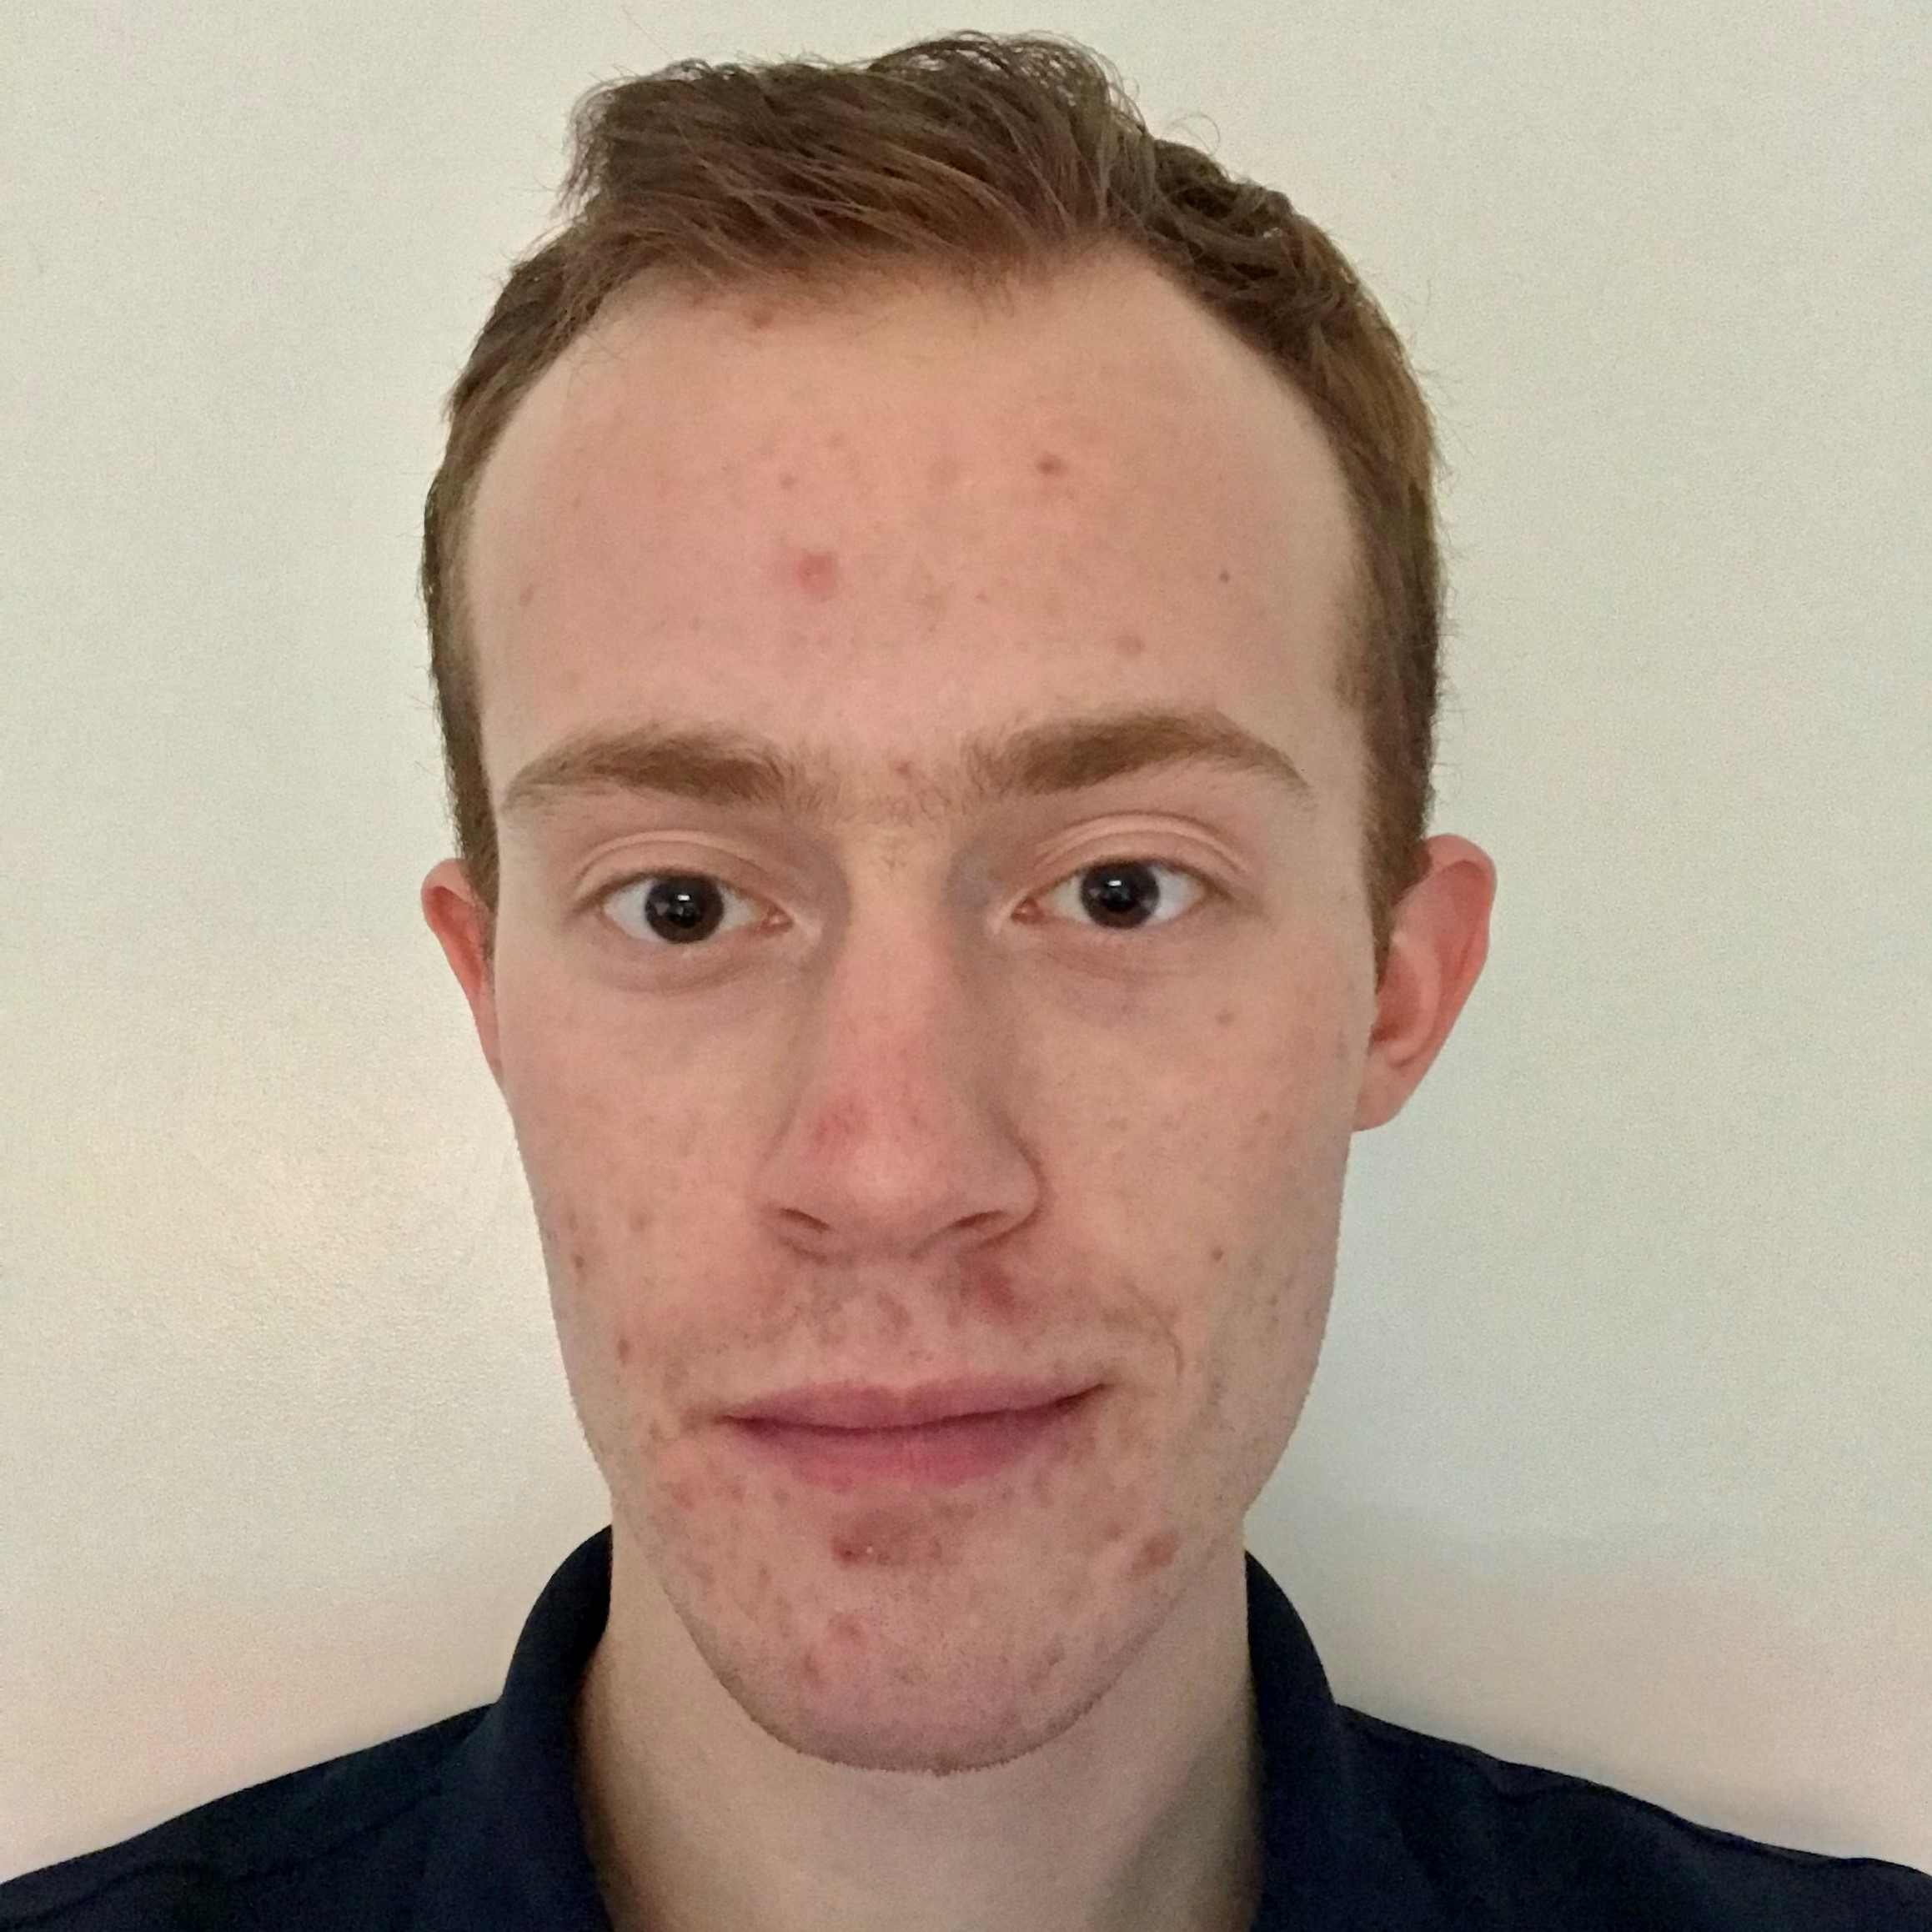
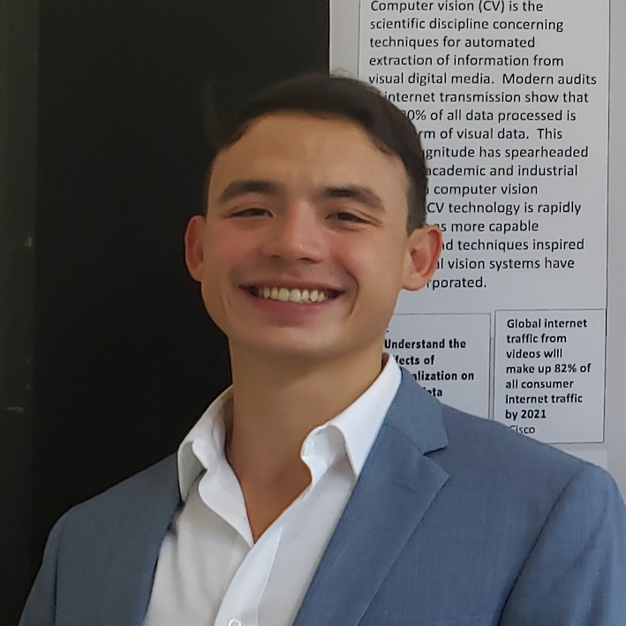
Team Members and Biographies
Colton Hurst
Team Lead - API/Database Architect
Colton Hurst is a senior at ODU, completing his Computer Science degree while working full time as a software engineer at PDI Software. In his scarce free time he enjoys Rust programming, working out, and cooking tasty food.
Dalton Hanbury
Webmaster
Dalton Hanbury is a Third year student at ODU studying for a Bachelor's in Computer Science. He's currently working part time for Nauticus in downtown Norfolk as a Museum Educator. When he's not doing classwork or working at Nauticus, he's usually playing airsoft with his team or building models.
Gregory Hubbard
Lead Researcher
Gregory Hubbard is a 4th year computer science student with a passion for learning. Currently, he works as an undergraduate research assistant in developing computer vision based behavioral imaging for clinical measures of autism spectrum disorder. His future goals include bridging the diverse applications of computer science to medicine.
FINAL PROTOTYPE PRESENTATION
12/8/21
Notes:
Just read the slides.

Slide 4
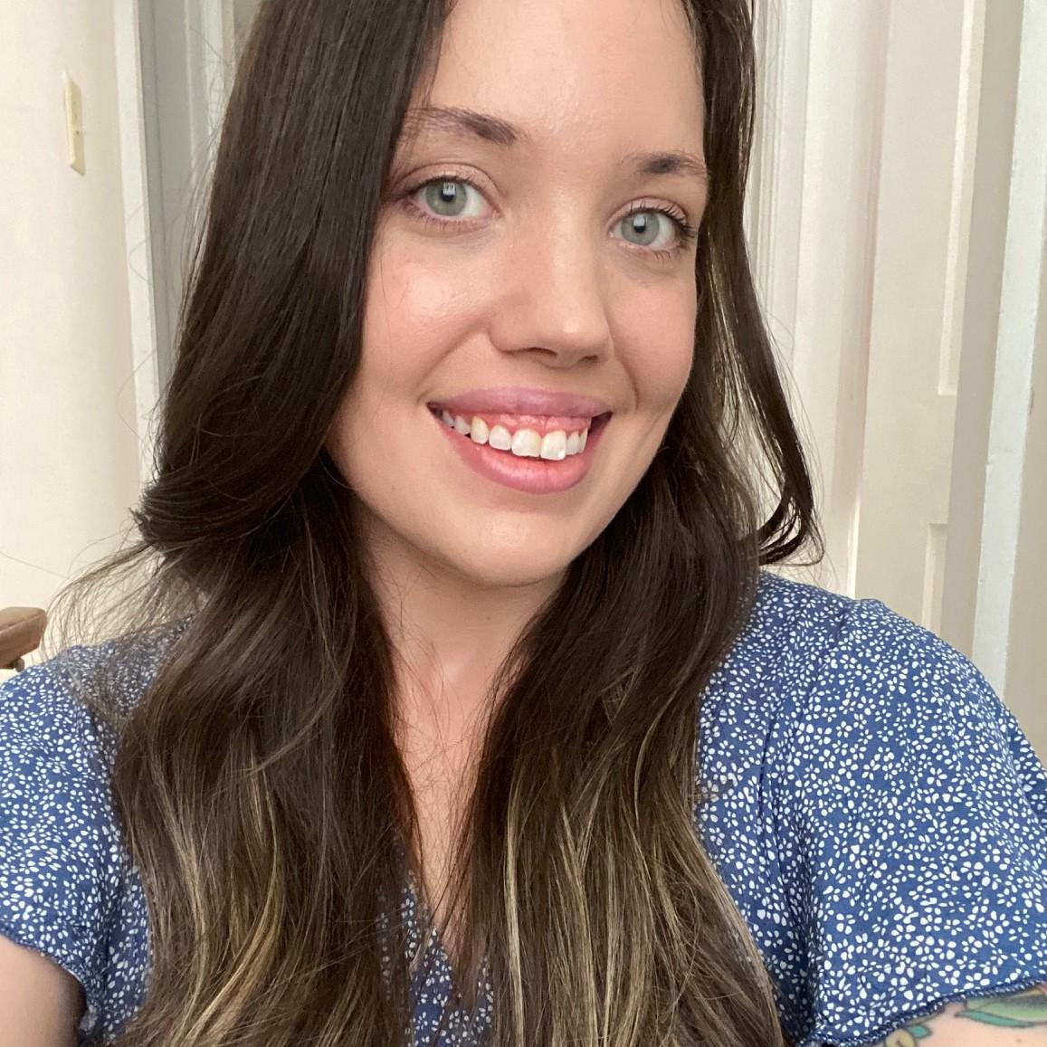

Team Members and Biographies
Aubrie Davie
Front-End Developer
Aubrie Davie is a senior at Old Dominion University pursuing a Bachelor's in Computer Science with a minor in Energy Engineering. She currently leads efforts to achieve sustainability goals set forth by the Department of Energy at Jefferson Lab in Newport News, Virginia. She lives with her husband, daughter on the James River.
Sergiy Yermak
Front-End Developer
Sergiy Yermak is a senior at Old Dominion University and expected to graduate in December of 2021. He is working to attain a Bachelor of Science in Computer Science. Before attending college he served in United States Navy. He enjoys a variety of things from skateboarding, diving, hiking, playing video games, and reading books.
FINAL PROTOTYPE PRESENTATION
12/8/21
Notes:
Just read the slides.

Slide 5
Table of Contents
Team Members and Biographies……………………………….. 2
Societal Problem………………………………………………….. 6
Problem Characteristics………………………………………….. 7
Solution Characteristics………………………………………….. 8
User Roles…………………………….…………………………... 9
User Stories………………...………………………………..……. 10
Prototype MFCD…………………………………………..………. 15
Prototype Feature Comparison………………………………….. 16
Development Tools……………………………………………….. 17
Application Technology…………………………………………… 18
Agile Sprints……………………………………………………….. 20
Risk Matrix………………………………………………….... ….... 21
FINAL PROTOTYPE PRESENTATION
12/8/21

Slide 6
Societal Problem
Young underprivileged students are adversely affected by having to learn online because of a lack of stable high-speed Internet (Anderson) and because they lack the knowledge and support at home needed to adapt when the Internet fails.
FINAL PROTOTYPE PRESENTATION
12/8/21
Notes:
Since about April of 2020, when schools first started to close because of COVID, there has been an increasing emphasis placed on the ability to do remote learning. While colleges have been working on solutions to learning online for decades now, the necessary changes caught grade schools off guard.
The few solutions school systems have been able to scramble together are not even close to being adequate. As a result, it is affecting students' ability to learn. Because of the lack of stable high-speed Internet and the lack of knowledge and support at home when the Internet fails, young underprivileged students are being hit the hardest by these changes.
Add note about what “young is” - (Kennedy told us this on 3/3 recitation)

Slide 7



Problem Characteristics
Affects younger students most
Lack of technical knowledge at home
Difficult to reach teachers
They have not built-up study habits
Older students more familiar with apps
Parents may not be tech savvy
Parents may be at work
Limited forms of contact
IT is not their specialty
FINAL PROTOTYPE PRESENTATION
12/8/21
Notes:
The root of the problem is that it affects younger students the most. As students get older, they become more and more familiar with the technology they use and therefore a solution for older students would not have as limiting an interface as one for younger children.
On the surface, the interface obstacle seems like it would be easy to overcome. If the student doesn't know how to do something on the computer then they can just ask their parents. The problem is many families don't know much more to do when an app goes wrong, an assignment fails to submit, or the internet goes out in the middle of quiz, than the students themselves do. Even worse, a lot of times, especially in underprivileged families, both parents may be busy trying to work while the student is in school and may not even be available to give technical help.
When there is a problem with the technology, and the student and parent don't know how to fix it, the next logical step is to reach out to the teacher for help. Unfortunately, this is not always easy to do if the teacher wants all interactions through email or Zoom and there isn't internet at home. To compound the problem, the teachers may be no more familiar with how to fix a technical problem than the student or parent, after all they are a teacher of English, Math, Science, Art, etc. Not a teacher of computer systems usually.

Slide 8




Solution Characteristics: Client App
Simple UI
Native App
Highly Automated
Video conferencing
Icons for buttons
Limited options
Everything they need in one place
Works without Internet
Targets Chromebook
Written in Java
Send/receive files
Zip/Unzip files
Weighted Priority Queue
Dropped Internet recovery
Downloads in sleep in Library
Opt-In
Only on stable Internet
In App notifications
FINAL PROTOTYPE PRESENTATION
12/8/21
Notes:
****Transition to Aubrie****
The software solution being proposed is a client app that will have a teacher view and a student view. Let’s start with the student portion of the app.
It will need to have a simple UI that is intuitive for children aged 5 to 13 to use. This may mean things like preferring icons over words for buttons, a limited number of options for each view, and all things for a single class found in one view. Since it needs to work when no internet is available, it should be a native app and not browser based. Based on the previous assumptions, the hardware will most likely be a Google Chromebook and so the software will likely be using Java as its primary language in the form of an Android app (Raphael). The student facing software will need to have a high level of automation and handle behind the scenes things like what to do when a student connects to Wi-Fi, uploading and downloading files, zipping and unzipping files all without the student needing to click on anything. All of this will also have the ability to be done while the computer is in sleep mode in a Library. There will need to be a weighted priority queue set up that places emphasis on downloading new assignments first, submitting completed assignments second, and finally downloading recorded video lecturers as the lowest priority. There will also be a need to detect and recover from a broken Internet connection when a file or packet is midstream being uploaded or downloaded.
Outside of this, there will be an optional video conferencing interface that students can opt into when they have stable Internet. Ideally there will be an indicator, possibly in the form of a chat bot, that notifies the student when a live video conference is about to start.
The teacher interface will be designed with convention over configuration in mind. This means a teacher will not be able to link to third party apps and resources on the web, and all class information and assignments will need to conform to a limited set of templates. This is out of necessity in order to keep things simple for the student.

Slide 9
User Roles
Student - User who needs access to their personal grades, download assignments, upload completed assignments, join live video sessions, and download recorded videos.
Teacher - Users who create assignments, grade assignments, create live sessions, control which content students can access and when, and perform simple reporting such as class grades.
School Administrator - Users who may need to do reporting on the information stored in the database such as grades, add and remove students from a class, but do not need the other teacher functions.
FINAL PROTOTYPE PRESENTATION
12/8/21
Notes:
We have 3 main roles in the Inclusive Classroom prototype. The biggest separation between roles from the technical level is the permissions and what they are allowed to access.
From most strict to least, we have the student, teacher, and school administrator. Students will have access to assignments, lectures, and personal grades. Teachers will be able to create assignments and lectures as well as assign grades to all students in their classes. School administrators will have an overarching role in inclusive classroom just as they do in an in-person learning environment. They will be able to create classes, evaluate teacher performance, and report on student performance.

Slide 10
Student User Stories
As a student on a personal device, I should be able to log into Inclusive Classroom for the first time using a username/password combination.
As a student, I should be able to use a school-provided Chromebook to complete all tasks.
As a student, I should be able to use a device using Windows 10 to complete all tasks.
As a student, I should be able to use a device using MacOS to complete all tasks.
As a student, I should be able to use a personal device using iOS to complete all tasks.
As a student, I should be able to use a personal device using Android to complete all tasks.
As a student, I should be able to complete an assignment without using the Internet.
As a student, when I complete an assignment offline, the teacher should still know at what time and date I completed it.
As a student, I should be able to easily navigate between different classes.
FINAL PROTOTYPE PRESENTATION
12/8/21
Notes:
Throughout the user stories, there are several stories that will apply to all user roles. For students, teachers, and school administrators, the user should be able to use a personal device with a Windows 10, MacOS, iOS, or Android operating system. All of the users should also have the ability to log into Inclusive Classroom using a username and password combination.
On an individual level, students should be able to:

Slide 11
Teacher User Stories
As a teacher, I should be able to log into Inclusive Classroom using a username/password combination.
As a teacher, I should be able to use a device using Windows 10 to complete all tasks.
As a teacher, I should be able to use a device using MacOS to complete all tasks.
As a teacher, I should be able to use a device using iOS to complete all tasks.
As a teacher, I should be able to use a device using Android to complete all tasks.
As a teacher, I should be able to create assignments.
As a teacher, I should be able to assign grades to completed assignments..
As a teacher, I should be able to create assignments with different styles of questions, such as multiple choice, fill in the blank, true/false, and short essay.
FINAL PROTOTYPE PRESENTATION
12/8/21
Notes:
Teachers should be able to:

Slide 12
School Administration User Stories
As a school administrator, I should be able to log into Inclusive Classroom using a username/password combination.
As a school administrator, I should be able to use a device using Windows 10 to complete all tasks.
As a school administrator, I should be able to use a device using MacOS to complete all tasks.
As a school administrator, I should be able to use a device using iOS to complete all tasks.
As a school administrator, I should be able to use a device using Android to complete all tasks.
As a school administrator, I should be able to report on an individual student's grades.
As a school administrator, I should be able to create classes to include assigning students and teachers to a class.
As a school administrator, I should be able to report on a class's grades.
As a school administrator, I should be able to evaluate a teacher's performance with their classes.
As a school administrator, I should be able to easily identify students who are struggling in multiple classes.
FINAL PROTOTYPE PRESENTATION
12/8/21
Notes:
School administrators should be able to report on an individual student’s grades, create classes, which includes assigning a teacher and students, report on a class’s grades, evaluate a teacher’s performance, and identify students struggling in multiple classes.
Today, we will be showing everyone how the Inclusive Classroom Prototype satisfies these user stories. Now, I would like to hand over the presentation to one of our lead front-end developers, Grant Ralls, and our lead back-end developer, Colton Hurst, to discuss prototype design, developer tools, and our application technology.

Slide 13
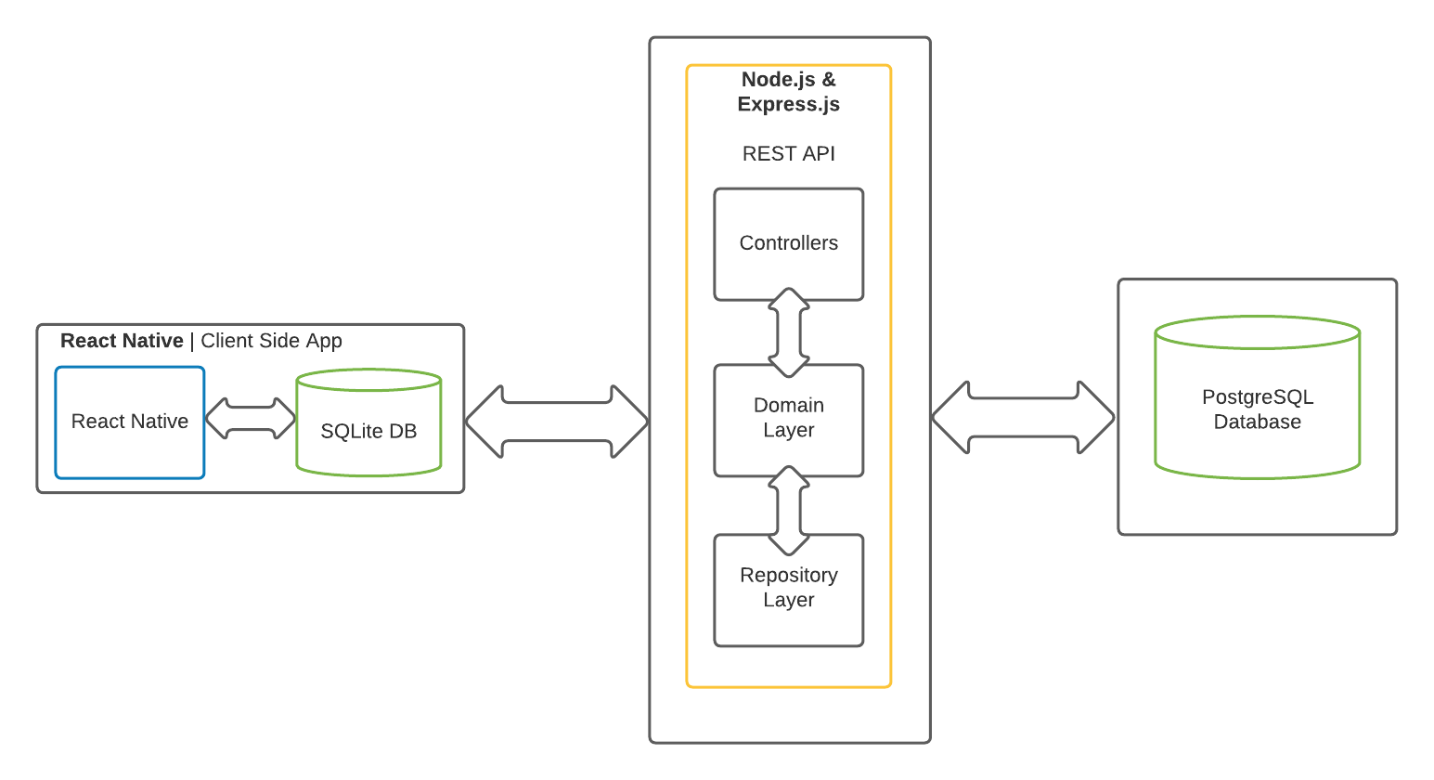
MFCD: Prototype
FINAL PROTOTYPE PRESENTATION
12/8/21
Notes:
GRANT & COLTON
Here is our MFCD (Major Functional Component Diagram) for our solution.
It is essentially split into two sections- the client side and backend side.
The client will be built with ReactNative and will only know of one api contract. (hence, the arrow to the cloud)
In reality, the redis caching layer will manage the backend cache and the api will sit behind it communicating with the database.
The backend will utilize Docker so that it can be deployed easily and in the future scale as needed.

Slide 14
Prototype Feature Comparison
Feature | RWP | Prototype | Actual Prototype
Account Roles | Student, Parent, Teacher, Admin, IT | Student, Teacher, Administrator(limited) only | Student, Teacher, Administrator (limited) only
Automatic Internet Detection | Yes | Yes | Yes
Background Workers | Yes | Partial | Partial
Complete/Submit Assignments | Yes | Yes | Partial (works in api)
Create Assignments | Yes | Yes, limited in types | Yes
Grade Assignments | Yes | Yes | Yes
Postdate created content | Yes | No | Partial (works in api)
Recorded Videos | Yes | Yes, may not auto record | Partial (file upload works in api)
Reporting | Yes | No | No
Timestamp Completed Assignments | Yes | Yes | Partial (works in api)
Video Conferencing | Yes | No | No
Weighted Priority Queue | Yes | Yes | Partial
FINAL PROTOTYPE PRESENTATION
12/8/21
Notes:
GRANT
Front End:
Account Roles - Randy
Automatic Internet Detection - SQLite Randy
Background Workers - Randy
Complete/Submit assignments - Dalton
Create Assignments - Grant
Grade Assignments - Grant
Postdate created content - N/A
Recorded Videos - Dalton
Reporting - N/A
Timestamp Completed Assignment - Dalton/Colton
Video Conferencing - N/A
Weighted Priority Queue - Randy/Grant
Backend:
Colton for all

Slide 15
Development Tools
Software: Hardware:
Version Control: Git (git-community.cs.odu.edu)
Other Repositories: GitHub
IDE: VSCode
Front end Framework: Expo/React Native
Unit and Integration Testing on Client App: Jest and react-testing-library
API Request Tracking: Postman
Issue Tracking: Jira
Documentation: Markdown via GitHub
Flowcharts: Lucid Chart
Client App: Windows 10/Mac/Chromebook
FINAL PROTOTYPE PRESENTATION
12/8/21
Notes:
COLTON
To build this complicated software, we have a list of the software and hardware that we have been using and will use in the development process.
We are using Git, the software, for version control, and our repo will be hosted on the ODU GitLab git community server.
We have other Git repositories hosted on GitHub.
Everything from Git for version control, Postman for API request testing & tracking, to using Windows, Mac, and Chromebook computers to test the software to ensure it’s fully compatible with whatever technology the school system may be using.

Slide 16



Application Technology : API
Language | JavaScript (Node.js)
Framework | Express.js
Database | PostgreSQL
FINAL PROTOTYPE PRESENTATION
12/8/21
Notes:
COLTON
Here are the technologies we’ll use in the backend for the api and for the database.
References for images (will source)
Node.js: https://en.wikipedia.org/wiki/Node.js
Express.js: https://javascript.plainenglish.io/3-express-js-features-you-need-to-know-8f78b0035f33
PostgreSQL: https://medium.com/backticks-tildes/resetting-your-postgres-database-f43ba9f1c601

Slide 17



Application Technology : Client Application
Language | Typescript
Framework | React Native/Expo
Database | SQLite
FINAL PROTOTYPE PRESENTATION
12/8/21
Notes:
GRANT
Here are the technologies we’ll use in the backend for the api and for the database.
References for images (will source)
Node.js: https://en.wikipedia.org/wiki/Node.js
React Native: https://troothy.com/react-native-reliable-technology/
SQLite: https://sqlite.org/index.html

Slide 18
Agile Sprints -Front End
Nov. 21, 2021 - Dec. 3, 2021
Teacher should be able to create assignments.
Students should be able to view assignments and submit to them before they are due (and not after).
Administrators should be able to view a list of students in a class and their overall grades and a student’s list of classes and their overall grade in each class.
Oct. 22, 2021 - Nov. 5, 2021
Add authentication to the login roles. Teacher, student, and school administrator should be able to login, see their account page, and reset their password, change account details, etc.
1
2
3
4
5
Oct. 7, 2021 - Oct. 21, 2021
Initial builds of client
Login roles defined; student should be able to log in via the client.
Details saved in DB via the API.
Dev tools should be configured and setup
Nov. 6, 2021 - Nov. 20, 2021
Teacher should be able to create classes and add students to the classes via the client.
Students should be able to see what classes they are in.
Administrators should be able to see a list of all teachers, create a class and assign teachers and students, and evaluate teacher performance.
Dec. 4, 2021 - Dec. 8, 2021
Teacher should be able to Grade submissions. Students should be able to watch the recording.
FINAL PROTOTYPE PRESENTATION
12/8/21
Notes:
GRANT
Above you can see the the agile sprint timeline
Each sprint is 2 weeks, and has a set of clearly defined goals that the team shoots to reach by the end of the sprint.
As mentioned before, the entire point of Agile is to get value to the business and customer as quickly as possible. The sooner they have something, in theory, the more beneficial it is to the customer and company.
We’ve only summarized above, but we have broken the main pieces of our product into 5 deliverables, that each have value and show something that is being delivered.
Briefly review each one.
*** Now I’ll hand it over to Dalton

Slide 19
Agile Sprints - Back End
Nov. 21, 2021 - Dec. 3, 2021
Add submission and list routes. Student should be able to view an assignment and create a submission. The list route will allow the app to access different lists of object based on views.
Oct. 22, 2021 - Nov. 5, 2021
Add role based login and account creation. This allows an admin to create accounts, and all 3 roles to log in with Basic Auth. Create setup scripts for development.
1
2
3
4
5
Oct. 7, 2021 - Oct. 21, 2021
Created the API Proposal v1. This defined functionality, contracts, and everything the client side should expect, as well as what routes they will be able to call. This allows for simultaneous development of both sides.
Nov. 6, 2021 - Nov. 20, 2021
Add assignment and class routes. A teacher should be able to create an assignment, and a student should be able to view the assignment. An admin should be able to create and update classes.
Dec. 4, 2021 - Dec. 8, 2021
The teacher should be able to grade assignments. Additionally add other routes as needed, final testing and integration with the client side. Ensure setup script complete.
FINAL PROTOTYPE PRESENTATION
12/8/21
Notes:
COLTON
Now we will hand it over to Sergiy

Slide 20
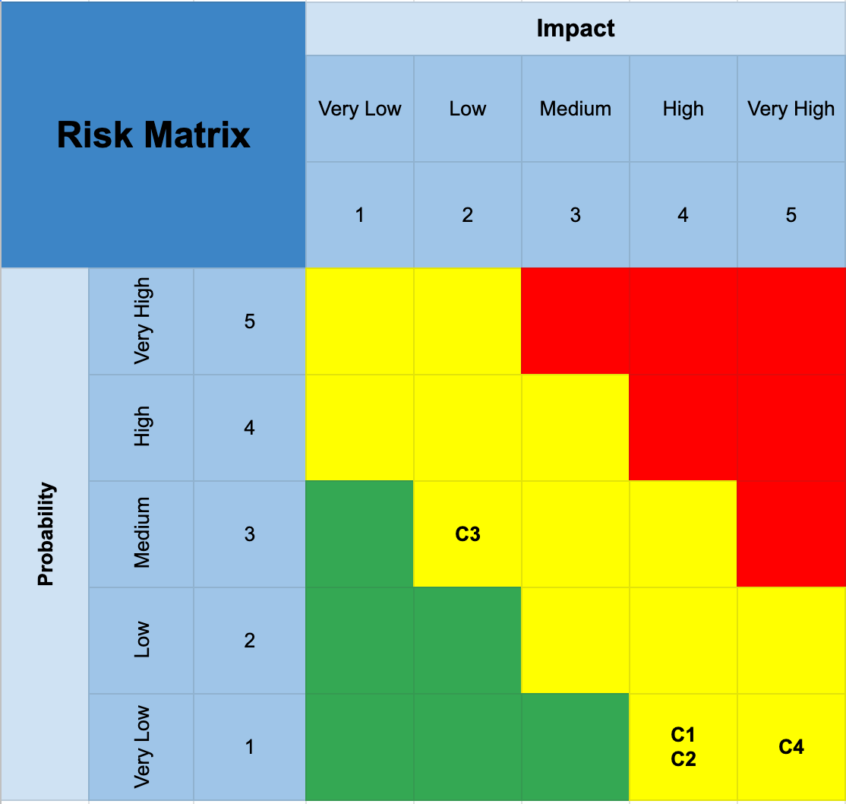
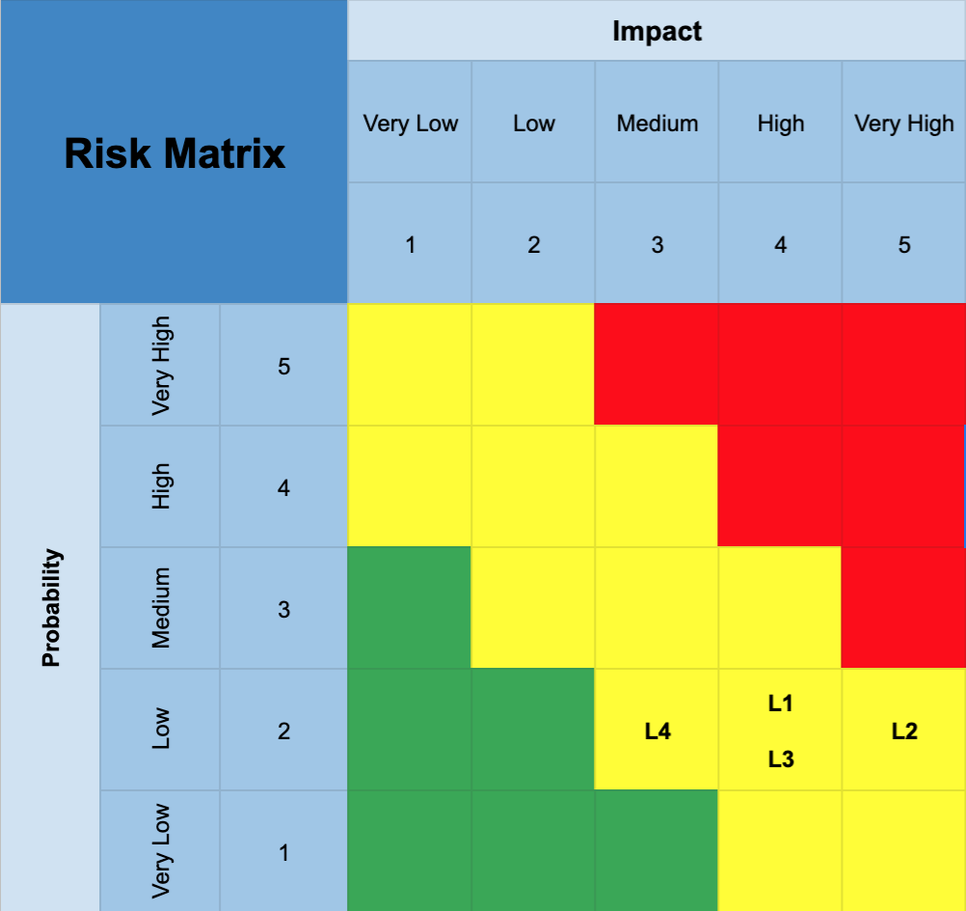
Risk Matrix: Customer & Legal Key: implemented mitigations =>
Risk ID | Title | Impact | Probability | Mitigation
C1 | Student Privacy | High | Low | Student data will only be available to the administrators that absolutely need it, and teachers can request permission for student data if needed. Teachers and school administrators will need to go through privacy training to follow FERPA guidelines.
C2 | Teacher Privacy | High | Low | Teacher data will only be available to the administrators that absolutely need it, and teachers can request permission for teacher data if needed. Teachers and school administrators will need to go through privacy training, and sign waivers to be recorded during lectures.
C3 | Missed or Ignored Reminders and Due Dates | Low | Medium | The Inclusive Classroom software can include an 'acknowledge' button that proves a student and/or parent, via email or the UI, has seen an announcement, due date, or other important piece of information.
C4 | Poor English | Very High | Very Low | Inclusive Classroom will be English only, but for students in ESL, a section of the UI can be translated to their selected language so that they can access ESL support through their language.
L1 | Children’s Online Privacy Protection Act | High | Low | Children’s data will be heavily protected and encrypted. Anyone with access will have to go through privacy training and access will be by “need” only. Inclusive Classroom will adhere to COPPA laws, and will only gather the minimum amount of data needed to complete our mission.
L2 | 504 Plan - Children with Disabilities | Very High | Low | Each school should have a “504 team” that will support any children with disabilities. There will be a special area in the UI for any students with disabilities, so that they can receive immediate help from the support team.
L3 | Litigation Risk | High | Low | Terms and conditions will be written up with legal support, and anyone using the software will have to agree to the terms. The goal will be for these to keep the company, the school system, and the students safe.
L4 | Contract Risk | Medium | Low | Any contracts that are drawn up will be reviewed and checked by the Inclusive Classroom legal teams. They will need to be audited to ensure that Inclusive Classroom can honor them while still achieving its goal.
FINAL PROTOTYPE PRESENTATION
12/8/21

Slide 21
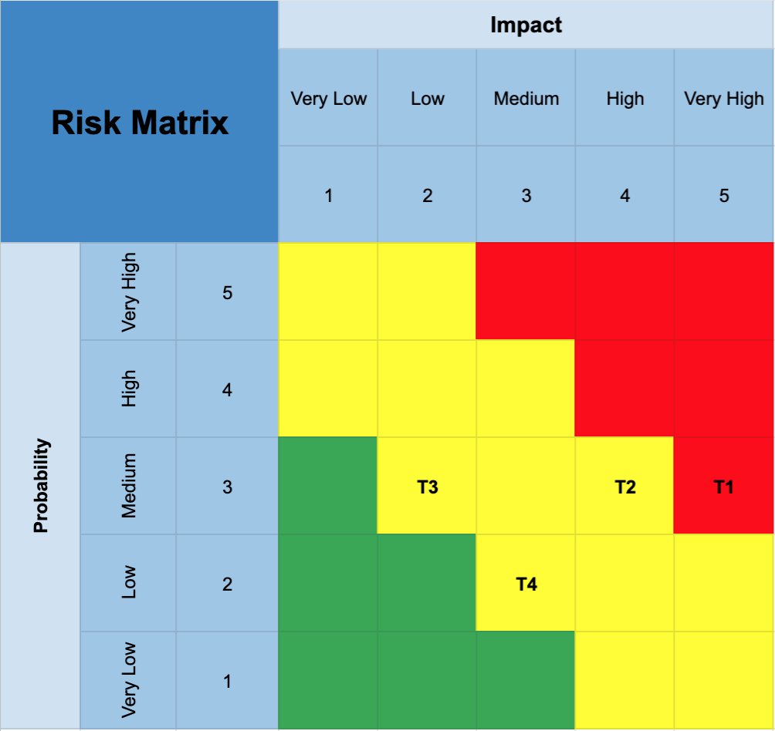
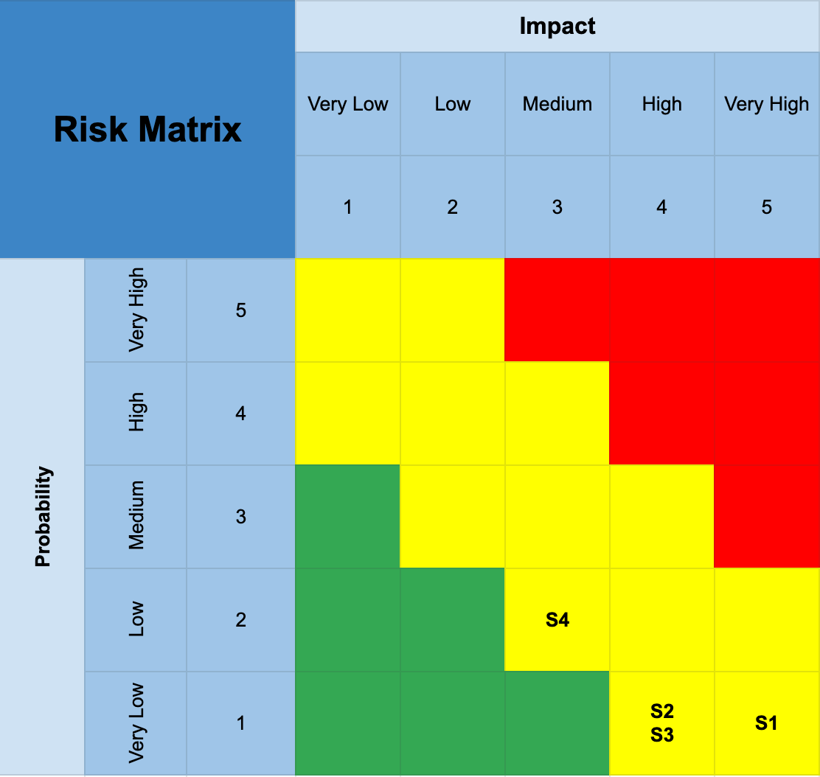
Risk Matrix: Technical & Security Key: implemented mitigations =>
Risk ID | Title | Impact | Probability | Mitigation
T1 | Loss of internet during stream | Very High | Medium | Flag session as unseen and automatically downloaded recorded version when internet is restored. Optionally, notify the teacher so they can follow up with the student for any extra help needed.
T2 | Loss of internet in mid file transfer | High | Medium | Automatically detect dropped packages and resend when internet is restored. A date will be stored for all file transfer attempts.
T3 | Assignments can not be sent until after due dates | Low | Medium | A timestamp will be created when student completes an assignment, and this timestamp will be used when comparing the submission date to due date. This will help ensure that the student can reliably submit assignments on time without internet.
T4 | Class updates not visible to students without internet | Medium | Low | Teachers will enter the syllabus into the system before the start of the year. All assignments and dates will be cached locally on the student side. Students can then receive updates throughout the semester without internet, and class updates will cache and change whenever connected if there are updates from the server.
S1 | SQL Injection | Very High | Very Low | Databases will be parameterized though typed parameters and careful use of stored procedures. All web components (libraries, plug-ins, web server, database server software) will be kept up to date for security patches, and input will be sanitized.
S2 | Data Release | High | Very Low | Sensitive student/teacher data will be encrypted on the backend in correspondence with privacy and FERPA laws. All transferred data will also be via HTTPS.
S3 | Broken Access Control | High | Very Low | Enforcement on the server-side logins will prevent students from accessing teacher permissions. Additional tests will be made to ensure specific URLs will be “hidden” without proper authentication.
S4 | Broken Authentication | Medium | Low | Authentication will be primarily based on school provided tokenization of student logins. Student passwords will be properly formed in a secure matter. Periodic password updates will be required to ensure security.
FINAL PROTOTYPE PRESENTATION
12/8/21

Slide 22
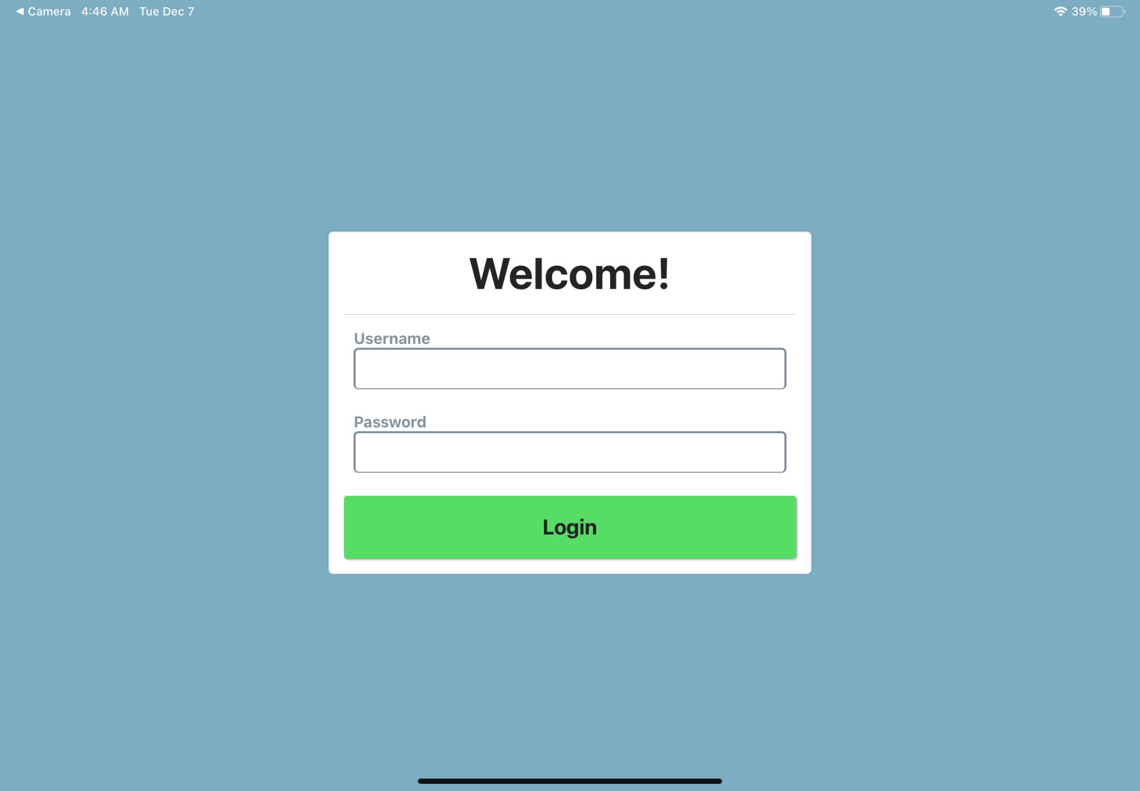
Login Page
Input for Username / Password
Verified by Database
Same view for all users (teacher / student / admin)
Login directs to respective main menu OR warning
Notes:
This is the first page of Inclusive Classroom
All users (teacher, student, administrators) access
Pretty generic and familiar presentation (avoid confusion)
Input for Username / Password
Verified by Database

Slide 23
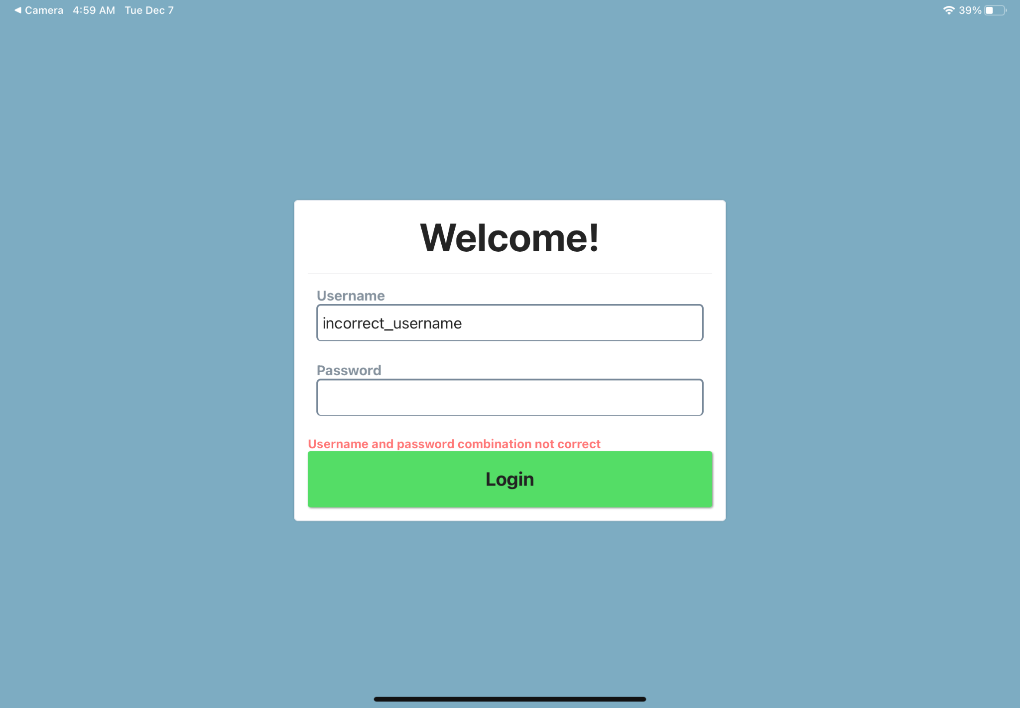
Login Page - Error
Error for incorrect username/password
Prevents user from proper login
Notes:
Quick example of what happens when username/password is incorrect

Slide 24
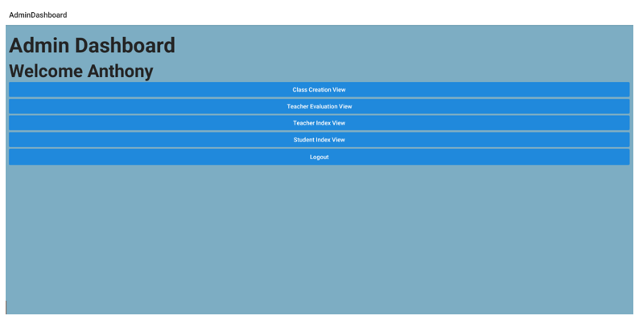
Admin Dashboard
Menu for Admin user
First Admin screen
Views available:
Class Creation View
Teacher Evaluation View
Teacher Index View
Student Index View
Logout
Notes:
Brief overview of the admin component of the application:
This is the main menu for Admin users
First screen for admins
5 different “views” available
The follwing slides will sequentially preview these options

Slide 25
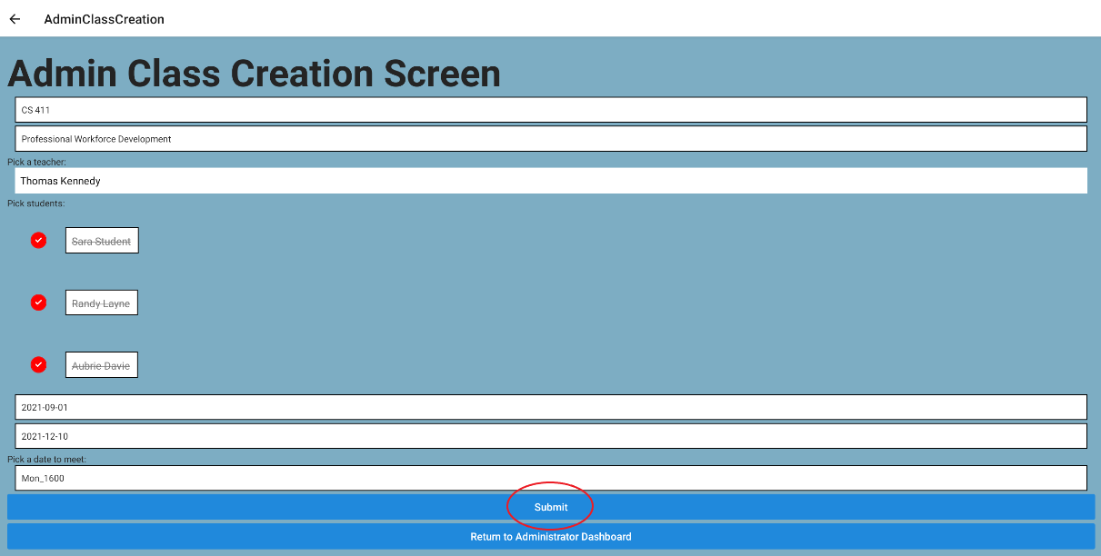
Class Creation View
class name and class description
"Pick a teacher" dropdown
“Pick students” selection
start and end date input (yyyy-mm-dd)
meeting time input (DayOfWeek_Time)
Submit saves and confirms data
Return to Administrator Dashboard
Notes:
This screen allows admin users to create classes
Options will include

Slide 26
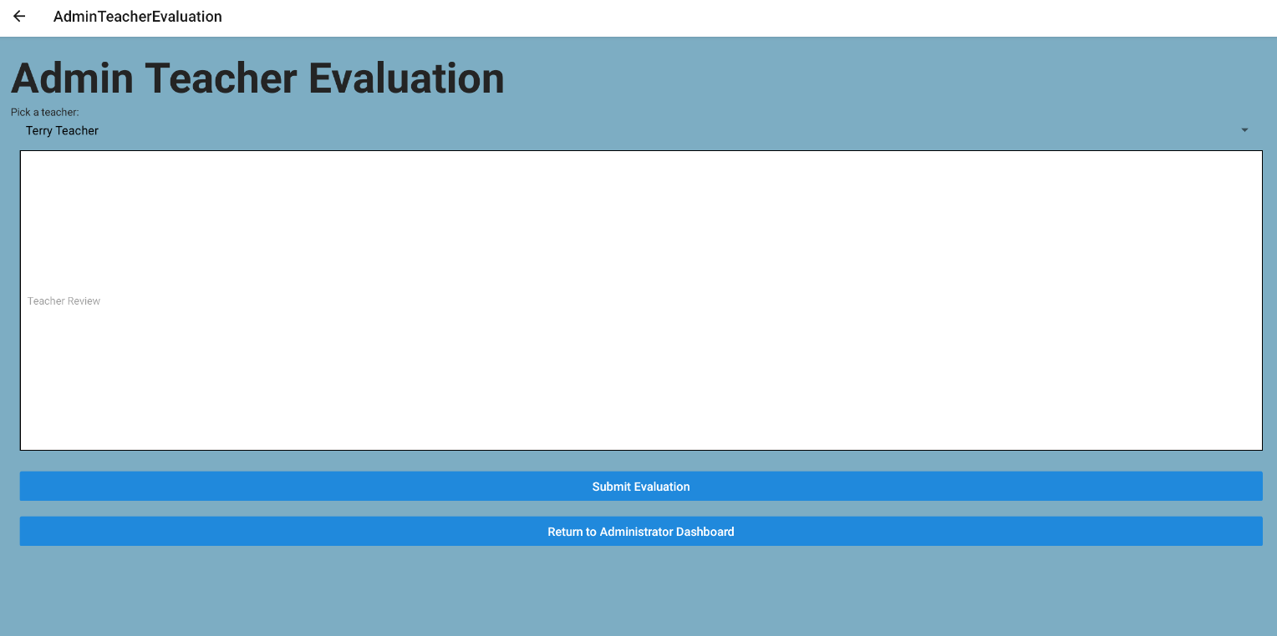
Teacher Evaluation
"Pick a teacher" dropdown
Empty text box for evaluation
Submit saves and confirms data
Return to Administrator Dashboard
Notes:
This view allows admin users to evaluate teachers

Slide 27
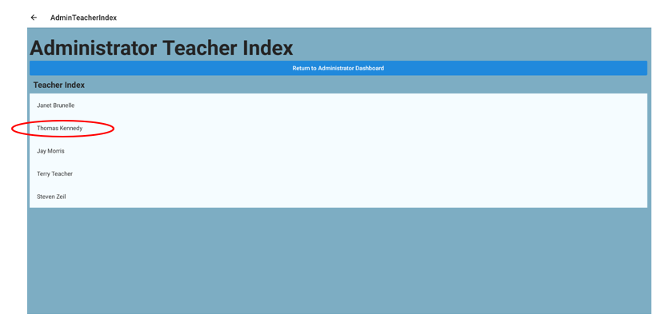
Teacher Index
List of all teachers
Click a teacher to expand information
Notes:
This screen allows admin users to view and access teacher information

Slide 28
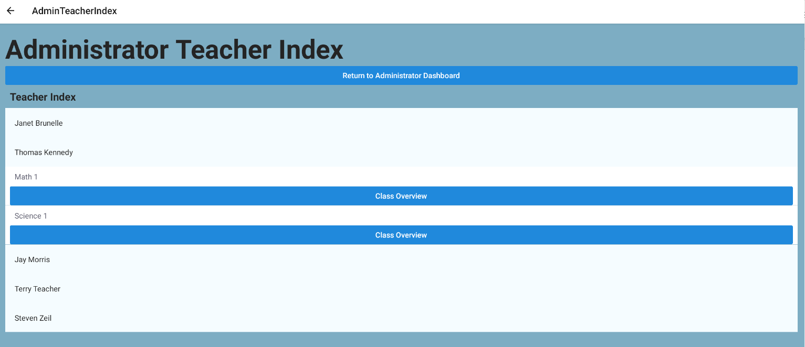
Teacher Index - Example
Classes assigned to selected teacher shown
Option to select “Class”:
class ID
class name
class description
class start and end dates
meeting times.
Option to select “Class Overview”:
list of all students assigned to a selected class and their overall grade
Notes:
This is an example of the dropdown that is expanded once a teacher is selected

Slide 29
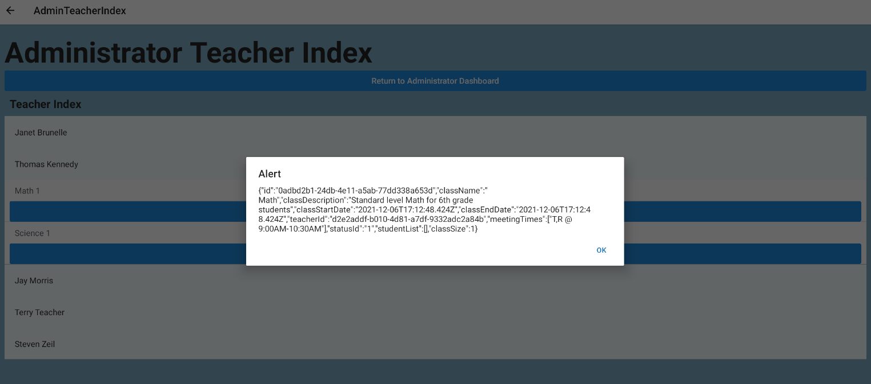
Teacher Index - Example (class)
Class details:
class ID
class name
class description
class start and end dates
meeting times.

Slide 30
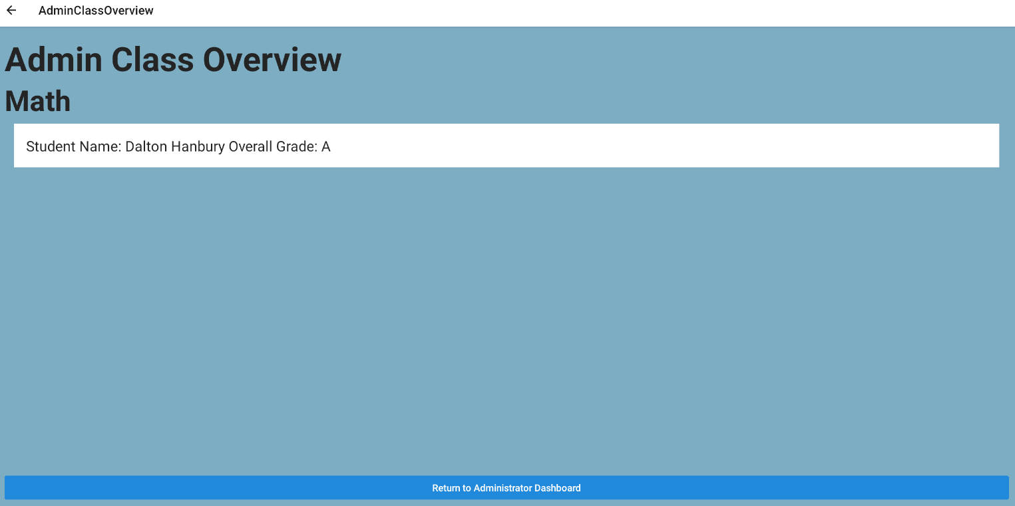
Class Overview - Example
Class details:
list of all students assigned to a selected class and their overall grade
Notes:
This screen allows admin users to view class information
Information included :
list of all students assigned to a selected class and their overall grade

Slide 31
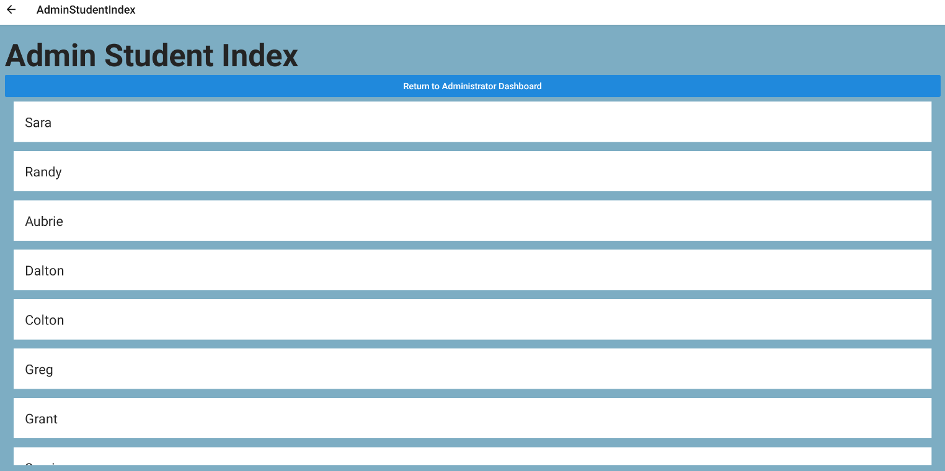
Student Index
List of all students enrolled
Clicking a student will reveal:
student's name
student ID
list of enrolled classes
overall grades.
Notes:
This screen allows admin users to view all student information
All active students are listed
Clicking a student reveals
Clicking a student will reveal:
student's name
student ID
list of enrolled classes
overall grades.

Slide 32
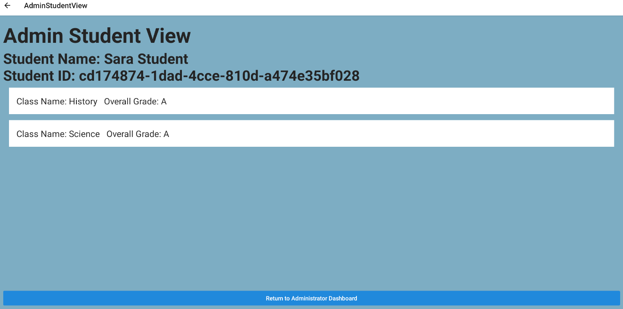
Student Index - Example
Example student selection
Revealed:
student's name
student ID
list of enrolled classes
overall grades.
Return to Administrator Dashboard
Notes:
Transition to Dalton

Slide 33
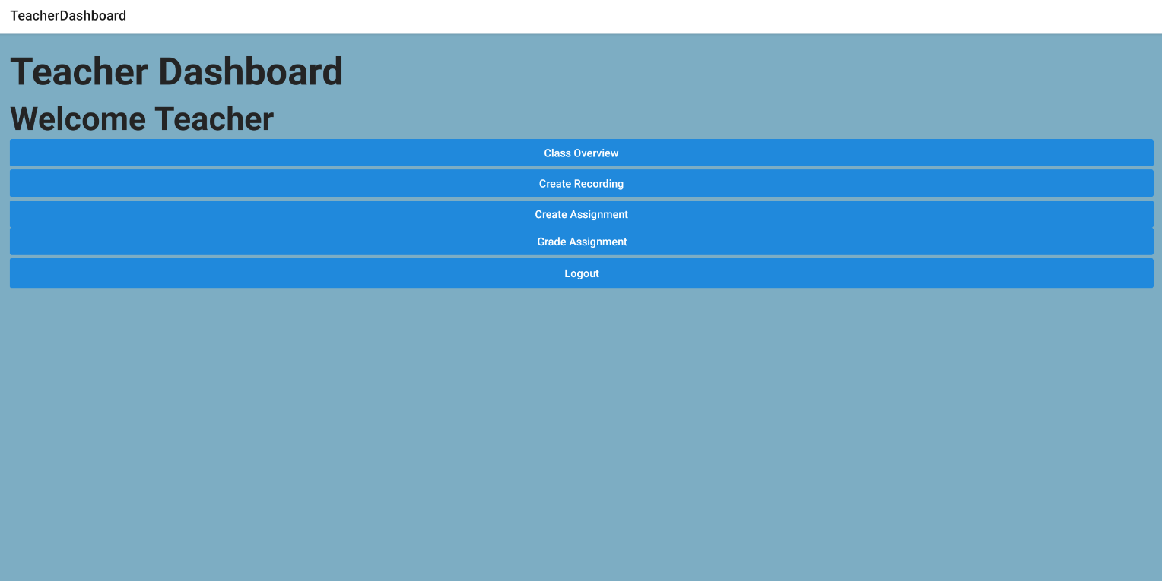
Teacher Dashboard
First Teacher View
Display links to overviews
Class overview
Recording overview
Creating Assignment
Grading of assignments

Slide 34
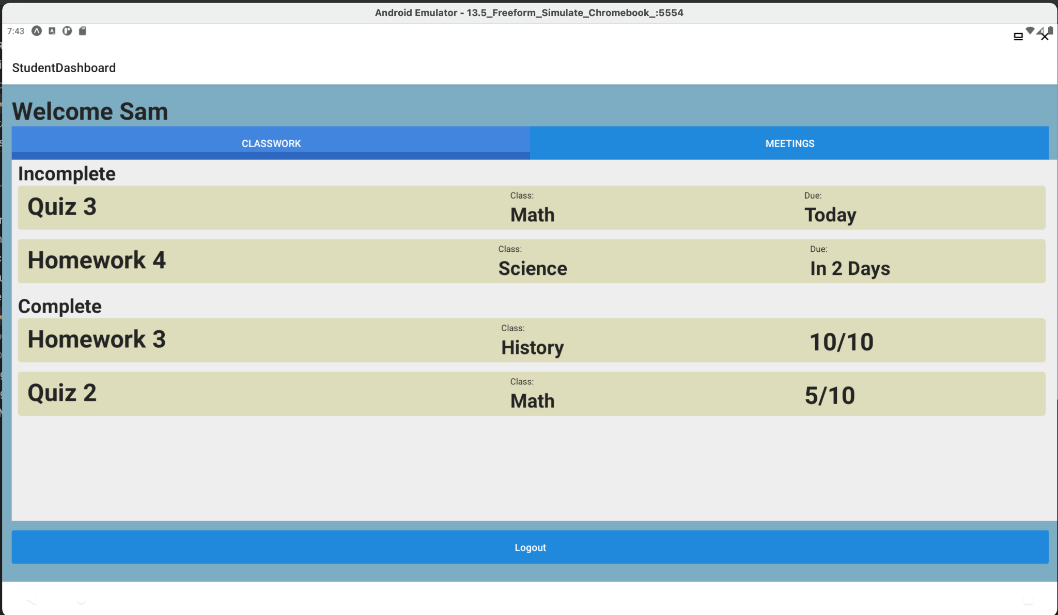
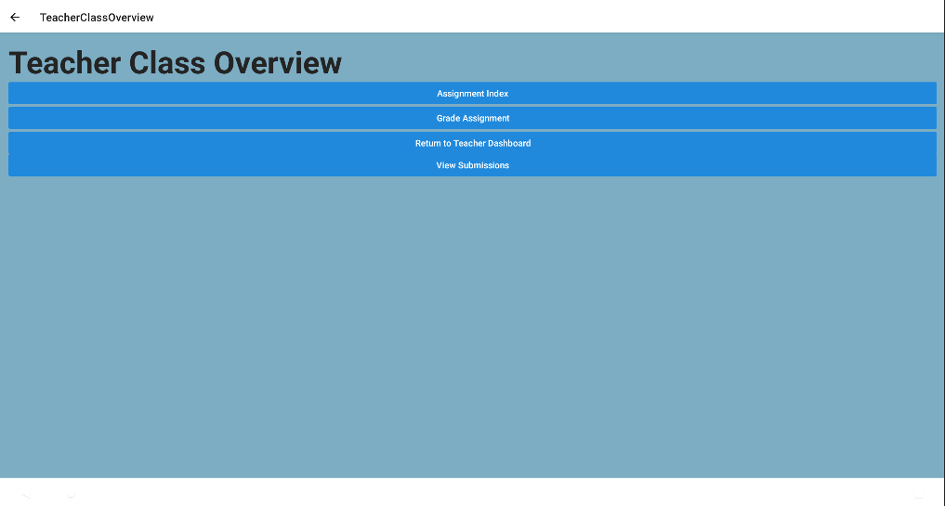
Teacher Class Overview
Class overview gives access to:
Assignment Index
Submissions

Slide 35
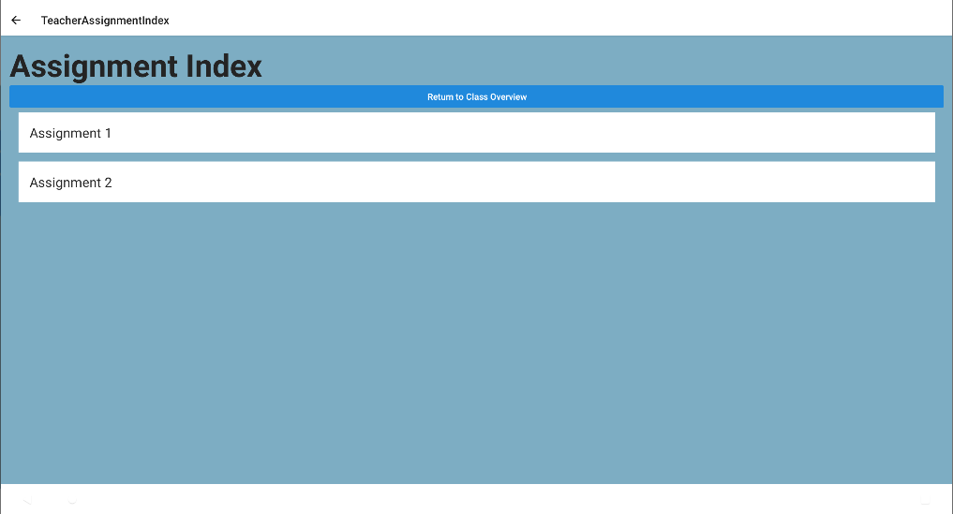
Teacher Assignment Index
List of assignments created by the teacher.

Slide 36
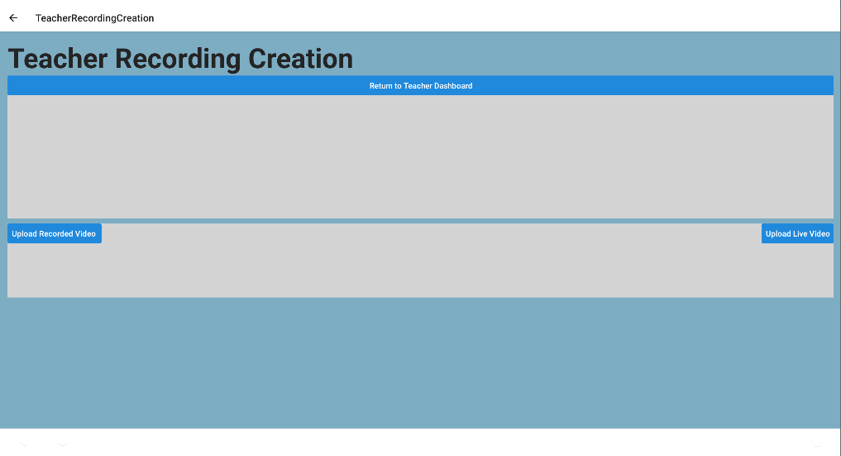
Teacher Recording Creation
Teacher can upload recorded videos for students to view.
Live is a link to zoom meeting
Recorded video would be a .mp4 or other file

Slide 37
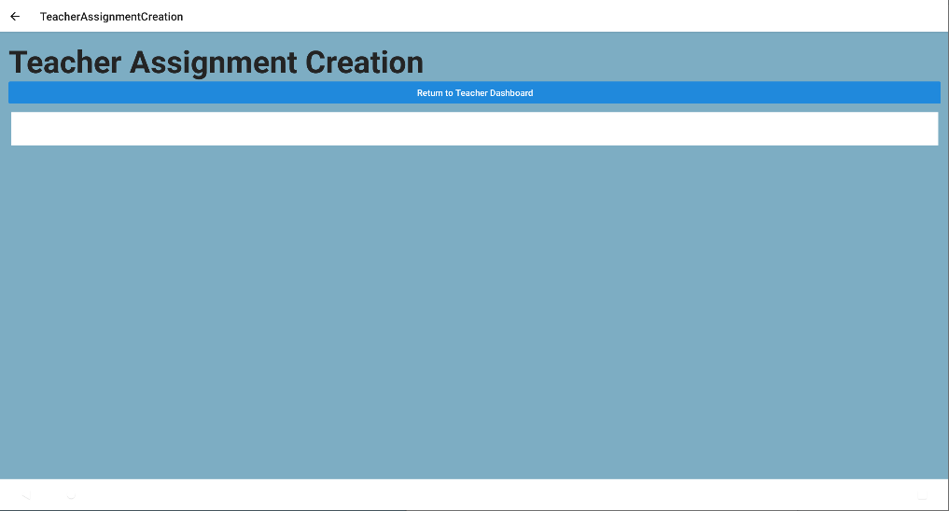
Teacher Assignment Creation Dashboard
Clicking on box will take teacher to point where assignments can be created.

Slide 38
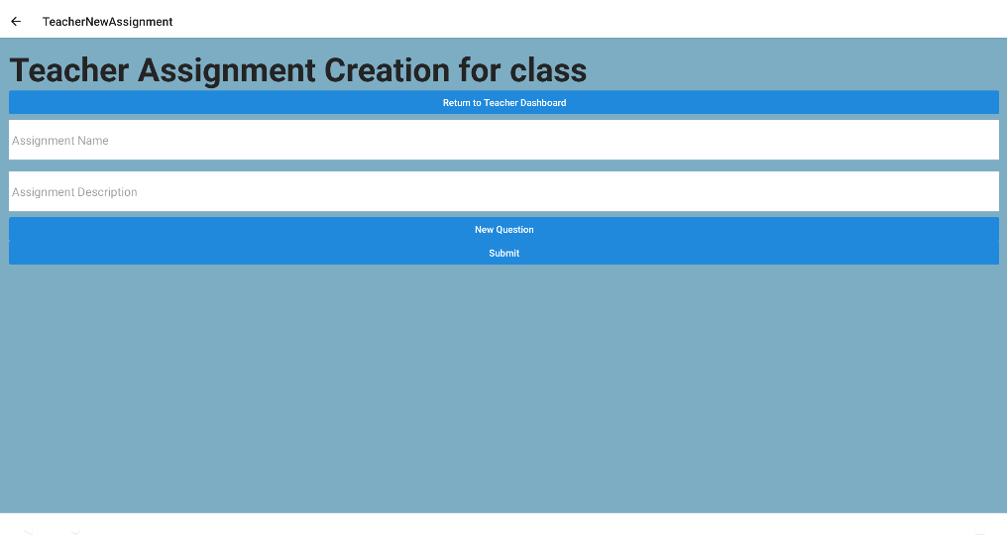
Teacher Assignment Creation
Template for creating assignments.
Can create as many questions as desired
3 question types
Radio
Checkbox
Short-answer
Submit assignments

Slide 39
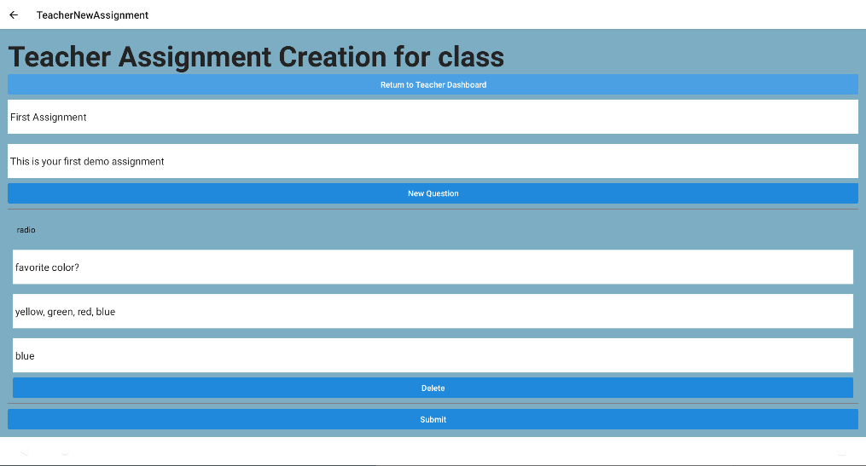
Teacher Assignment Creation - Example
Allows naming of assignment and description
Create new questions with different question types:
Radio
Short-answer
Checkbox
Submit assignments

Slide 40
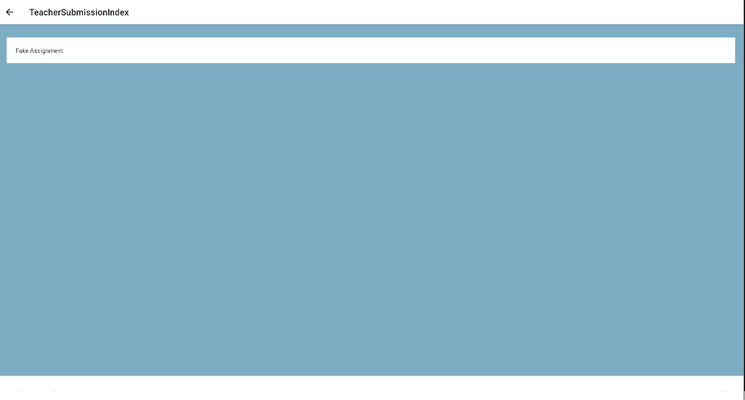
Teacher Grading Assignment
Will list an assignment that needs to be graded.
Clicking will bring teacher to view where assignment is graded.

Slide 41
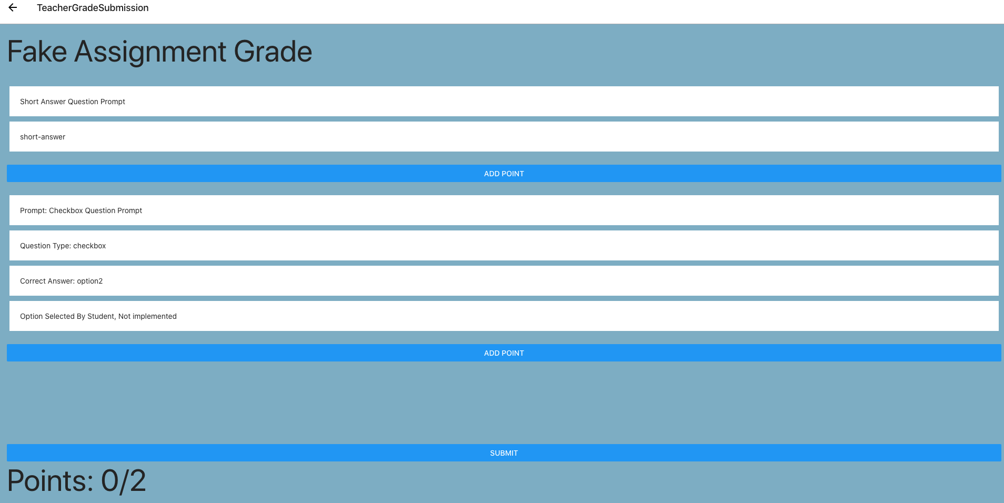
Teacher Grading Submission
Teacher can give points for assignments by a student.
Add points and submit
Student answers visible

Slide 42
Student Classwork Dashboard
First Student View
List of completed and incomplete assignments
Classes associated with assignments
Due dates in relative time.
Completed assignments display the grade received if applicable.

Slide 43
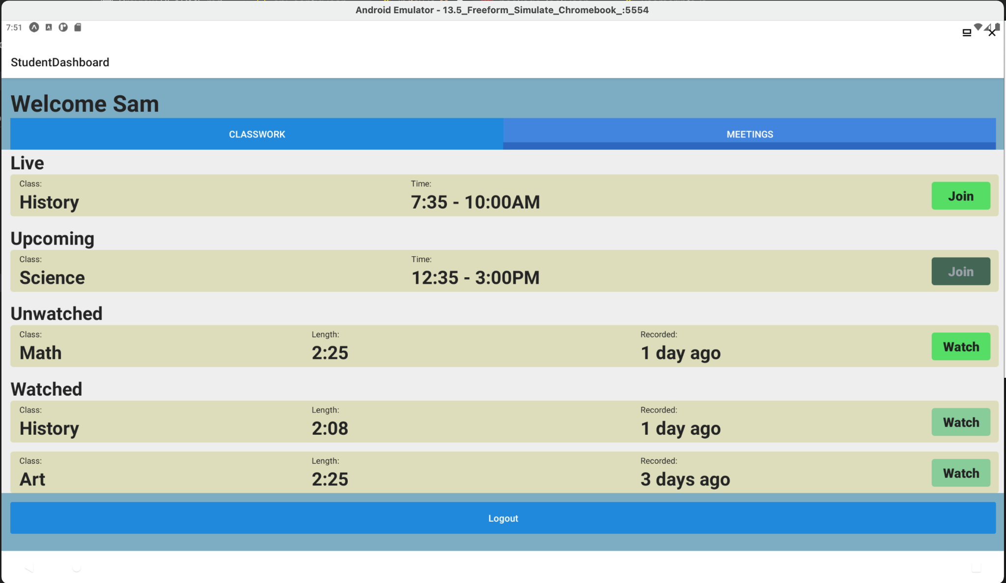
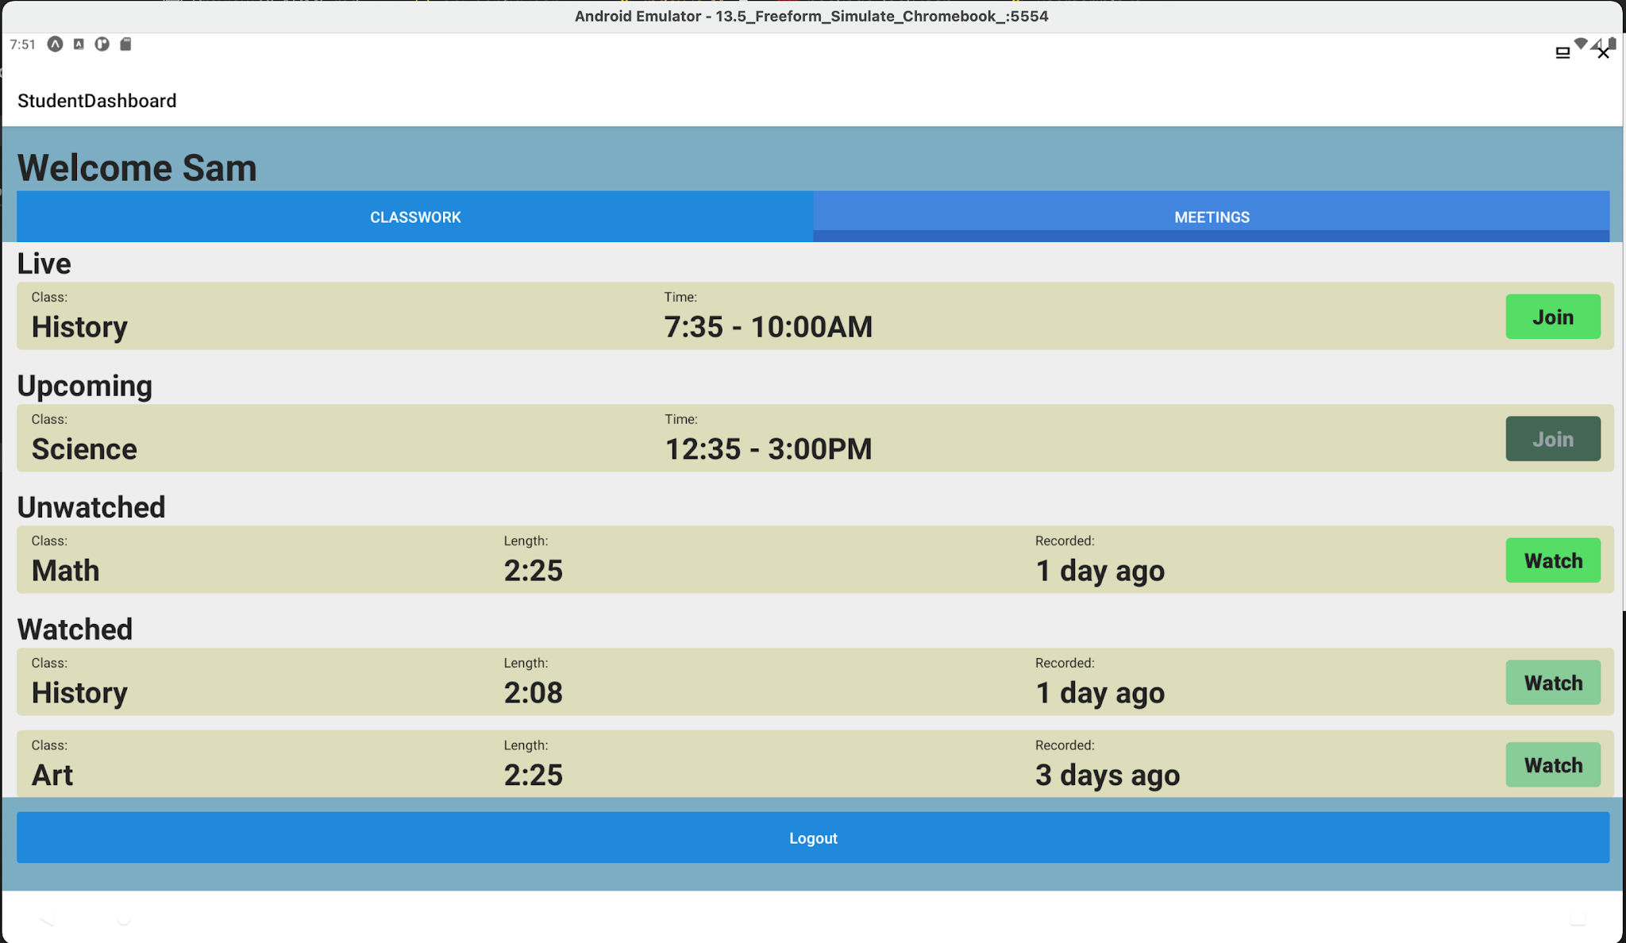
Student Meeting Dashboard
Second tab for the classwork/dashboard
List of ongoing and upcoming meetings
Time meetings occurred and ability to join in progress
List of watched and unwatched meetings
Length of meeting and date recorded in relative time
Notes:
TRANSITION TO TRAVIS

Slide 44
Prototype Presentation Sequence
School Administrator Users
Login
Dashboard
Class Creation
Teacher Evaluation
Teacher Index
Class Overview
Student View
Student Index
Student View
Logout
Teacher Users
Login
Dashboard
Assignments
Logout
Student Users (Online and Offline):
Login
Dashboard
Assignments
Logout
API
FINAL PROTOTYPE PRESENTATION
12/8/21
Notes:
The prototype demonstration for the client app will be separated into 3 parts: the administrator role, teacher role, and student role. We will start with the administrator role. When they log in they will be directed to their dashboard. From there they can create classes, evaluate teachers, and view both teacher and student index. Within the teacher index administrators can view classes and then from there students in those classes. Within the student index administrators can view a list of all students and the classes they are in. Finally, there is the function of logging out.
Next we will showcase the teacher role. When they log in they will be directed to their dashboard. From there they can create assignments and view the classes they are teaching. Within a class there is an assignment index which lists the assignments for that class. Last we will show the ability to logout.
Finally we will showcase the student role. For this role we will be showcasing online and offline capabilities. When they log in they will be directed to their dashboard. From there they can navigate to class meetings and assignments. Finally we will show the ability to logout.
Following the client app demo, there will be a demo for the back end.

Slide 45

Questions?
FINAL PROTOTYPE PRESENTATION
12/8/21
‹#›

Slide 46
Prototype Demonstration is Next

Slide 47
References
Anderson, Monica, and Andrew Perrin. “Nearly One-in-Five Teens Can't Always Finish Their Homework Because of the Digital Divide.” Pew Research Center, Pew Research Center, 30 May 2020, www.pewresearch.org/fact-tank/2018/10/26/nearly-one-in-five-teens-cant-always-finish-their-homework-because-of-the-digital-divide/.
“Children’s Online Privacy Protection Rule (‘COPPA’).” Federal Trade Commission, 1 Dec. 2020,www.ftc.gov/enforcement/rules/rulemaking-regulatory-reform-proceedings/childrens-online-privacy-protection-rule.
“Chromebook Support.” LCS, www.lcsedu.net/departments/information-technology/chromebook-support.
“Classroom FAQ - Classroom Help.” Google, Google, support.google.com/edu/classroom/answer/6025224?hl=en&ref_topic=7175444.
Del Razo, Gabriel, et al. “LittleLEARNERS.” Team Orange, www.cs.odu.edu/~cpi/old/410/orangf20/.
ICTP Science Dissemination Unit, ICTP Science Dissemination. “ICTP-SDU Home Page.” ICTP-SDU: about PingER, web.archive.org/web/20131010010244/sdu.ictp.it/pinger/pinger.html.
Kamenetz, Anya, and Eda Uzunlar. “NPR/Ipsos Poll: Nearly One-Third Of Parents May Stick With Remote Learning.” NPR, NPR, 5 Mar. 2021, www.npr.org/2021/03/05/973373489/npr-ipsos-poll-nearly-one-third-of-parents-may-stick-with-remote-learning.
Raphael, JR. “Android Apps for Chromebooks: The Essentials.” Computerworld, Computerworld, 19 Feb. 2019, www.computerworld.com/article/3234533/android-apps-for-chromebooks-the-essentials.html.
Schoolov, Katie. “Google Is Winning in Education, but Apple and Microsoft Are Battling for Market Share.” CNBC, CNBC, 20 Mar. 2019, www.cnbc.com/2019/03/20/apple-google-microsoft-are-battling-for-dominance-in-education.html.
FINAL PROTOTYPE PRESENTATION
12/8/21

Slide 48
References
“Section 504 & Students with Disabilities.” Washington Office of Superintendent of Public Instruction, 2021, k12.wa.us/policy-funding/equity-and-civil-rights/information-families-civil-rights-washington-schools/section-504-students-disabilities.
“System Requirements for Windows, MacOS, and Linux.” Zoom Help Center, support.zoom.us/hc/en-us/articles/201362023-System-Requirements-for-PC-Mac-and-Linux.
“The 504 Plan.” The Center for Children with Special Needs, 2018, cshcn.org/childcare-schools-community/the-504-plan.
VBCPS. “VBCPS Adds 19,000 Chromebooks to Achieve 1:1.” Virginia Beach City Public Schools, www.vbschools.com/news/archived_news/2019/chromebooks.
VDH. “COVID 19 Cases In Virginia.” Virginia Department of Health., www.vdh.virginia.gov/coronavirus/coronavirus/covid-19-in-virginia-cases/. Accessed 20 Feb 2021
Vogels, Emily A. “59% Of U.S. Parents with Lower Incomes Say Their Child May Face Digital Obstacles in Schoolwork.” Pew Research Center, Pew Research Center, 10 Sept. 2020, www.pewresearch.org/fact-tank/2020/09/10/59-of-u-s-parents-with-lower-incomes-say-their-child-may-face-digital-obstacles-in-schoolwork/.
“Web Applications with Spring.” Spring, spring.io/web-applications.
FINAL PROTOTYPE PRESENTATION
12/8/21

Slide 49
Glossary
ESL - English as a Second Language
Family Educational Rights and Privacy Act (FERPA) - Federal law that protects the privacy of student education records
Google Classroom - “Free web service developed by Google for schools that aims to simplify creating, distributing, and grading assignments” (Google)
High-speed Internet - Internet with consistent download speeds of at least 3.8 Mbps (Zoom) HTTP – Hypertext Transfer Protocol
IC - Inclusive Classroom
littleLearners - Former CS 410 group solution that emphasizes simple UI for students in the K-5 age range (Del Razo)
ORM – Object-relational mapping; programming technique for converting data between incompatible type systems
RFC – Request for Comments; a formal document from the Internet Engineering Task Force
Stable Internet - Internet with less than 1% dropped packets (ICTP)
UI - User Interface
FINAL PROTOTYPE PRESENTATION
12/8/21

